Slide 1
Computer Architecture
CSC2206/CSC2231
Instructor: Hadiza Umar

Slide 2
History of Computers
The First Generation: Vacuum Tubes ENIAC
The ENIAC (Electronic Numerical Integrator and Computer), designed and constructed at the University of Pennsylvania, was the world’s first general-purpose electronic digital computer. The project was a response to U.S. needs during World War II.
Was a decimal rather than a binary machine.
Its memory consisted of 20 “accumulators,” each capable of holding a 10-digit decimal number. A ring of 10 vacuum tubes represented each digit. At any time, only one vacuum tube was in the ON state, representing one of the 10 digits.
The major drawback of the ENIAC was that it had to be programmed manually by setting switches and plugging and unplugging cables.

Slide 3
Classes of Computing Applications and Their Characteristics
Personal computers (PCs)
- delivery of good performance to single users at low cost and usually execute third-party soft ware.
- drove the evolution of many computing technologies, which is only about 35 years old!
Servers
- are the modern form of what were once much larger computers
- usually accessed only via a network
- oriented to carrying large workloads, large storage and great output
- consist of either single complex applications (scientific or engineering application
- based on software from another source (such as a database or simulation system), often modified or customized for a particular function.
- greater emphasis on dependability

Slide 4
Classes of Computing Applications and Their Characteristics
Supercomputers
- consist of tens of thousands of processors and many terabytes of memory
- expensive
- used for high-end scientific and engineering calculations, large scale problems
Embedded computers
- largest class of computers and span the widest range of applications and performance
- include the microprocessors found cars, television set, networks of processors that control a modern airplane or cargo ship
- computing systems are designed to run one application or one set of related
- integrated with the hardware, delivered as a single system

Slide 5
Classes of Computing Applications and Their Characteristics
Personal Mobile device (PMD)
- PMDs are battery operated with wireless
- Connectivity to the Internet and typically costly
- Users can download soft ware (“apps”) to run on them
- Unlike PCs, they no longer have a keyboard and mouse, and are more likely to rely on a touch- sensitive screen or even speech input.
- Today’s PMD is a smart phone or a tablet computer or in future may include electronic glasses
Cloud Computing
- Giant data centres that are now known as Warehouse Scale Computers (WSCs)
- Companies like Amazon and Google build these WSCs containing 100,000 servers
- Companies rent portions of them so that they can provide software services (Soft ware as a Service (SaaS)) to PMDs

Slide 6
8 Great Ideas Produced by Computer Architects
Design for Moore’s Law
- Constant for computer designers is rapid change, driven largely by Moore’s Law.
Moore’s Law states that: “Integrated circuit (IC) resources double every 18–24 months.”
2. Use Abstraction to Simplify Design
- A major productivity technique for hardware and soft ware is to use abstractions (quality of dealing with ideas rather than events) to represent the design at different levels of representation
3. Make the Common Case Fast
- Making the common case fast will tend to enhance performance better than optimizing the rare case. Ironically, the common case is often simpler than the rare case and hence is often easier to enhance.

Slide 7
8 Great Ideas Produced by Computer Architects
4. Performance via Pipelining
- A particular pattern of parallelism in computer architecture called pipelining.
5. Performance via Prediction
- Prediction: In some cases it can be faster on average to guess and start working rather than wait until you know for sure, assuming that the mechanism to recover from a misprediction is not too expensive and the prediction is relatively accurate.

Slide 8
8 Advancements Produced by Computer Architects
6. Hierarchy of Memories
- Programmers want memory to be fast, large, and cheap, as memory speed often shapes performance
- capacity limits the size of problems that can be solved, and the cost of memory today is often the majority of computer
- address these conflicting demands with a hierarchy of memories, with the fastest, smallest, and most expensive memory per bit at the top of the hierarchy and the slowest, largest, and cheapest per bit at the bottom. Caches give the programmer the illusion that main memory is nearly as fast as the top of the hierarchy and nearly as big and cheap as the bottom of the hierarchy.

Slide 9
8 Advancements Produced by Computer Architects
7. Performance via Parallelism
- Since the dawn of computing, computer architects have offered designs that get more performance by performing operations in parallel.
8. Dependability via Redundancy
- Computers not only need to be fast; they need to be dependable. Since any physical device can fail, systems are made dependable by including redundant components that can take over when a failure occurs and to help detect failures.

Slide 10
What is Computer Organisation?
Computer organisation It also refers to the operational units and their interconnections that realize the architectural specifications. It addresses issues such as control signals (how the computer is controlled), signalling methods, and memory types/technology and interfaces between the computer and peripherals. It encompasses all physical aspects of computer systems.
It helps us to answer the question: How does a computer work?

Slide 11
What is Computer Architecture?
Computer architecture refers to those attributes of a system visible to a programmer or those that directly impact the logical execution of a program. Examples of architectural attributes include the instruction set, the number of bits used to represent various data types (e.g., numbers, characters), I/O mechanisms, and techniques for addressing memory. Computer architecture comprises rules, methods, and procedures that describe the execution and functionality of the entire computer system. In general terms, computer architecture refers to how a computer system is designed using compatible technologies.
Studying computer architecture helps us to answer the question: How is a computer system designed?

Slide 12
Types of Computer Architecture
Von-Neumann Architecture
Harvard Architecture
Instruction Set Architecture
Micro-architecture

Slide 13
Von-Neumann Architecture
John von Neumann coined and developed this architecture. The computer we are using nowadays is based on the von Neumann architecture. It has some concepts. It is also known as Princeton architecture. It renders a unique design for the electronic digital systems having the following components:
A Central Processing Unit (CPU) with arithmetic and logic unit (ALU) and processors with attached registers.
A memory that can store data and instructions.
External mass storage or secondary storage.
A Control Unit (CU) with the ability to hold instructions in the program counter (PC) or instruction register (IR).
Input and output mechanisms and peripherals.
The von Neumann design thus constitutes the foundation of modern computing. The Harvard architecture, a similar model, had committed data addresses and buses for reading and writing to memory. It wins because von Neumann's architecture was more straightforward to execute in real hardware.

Slide 14
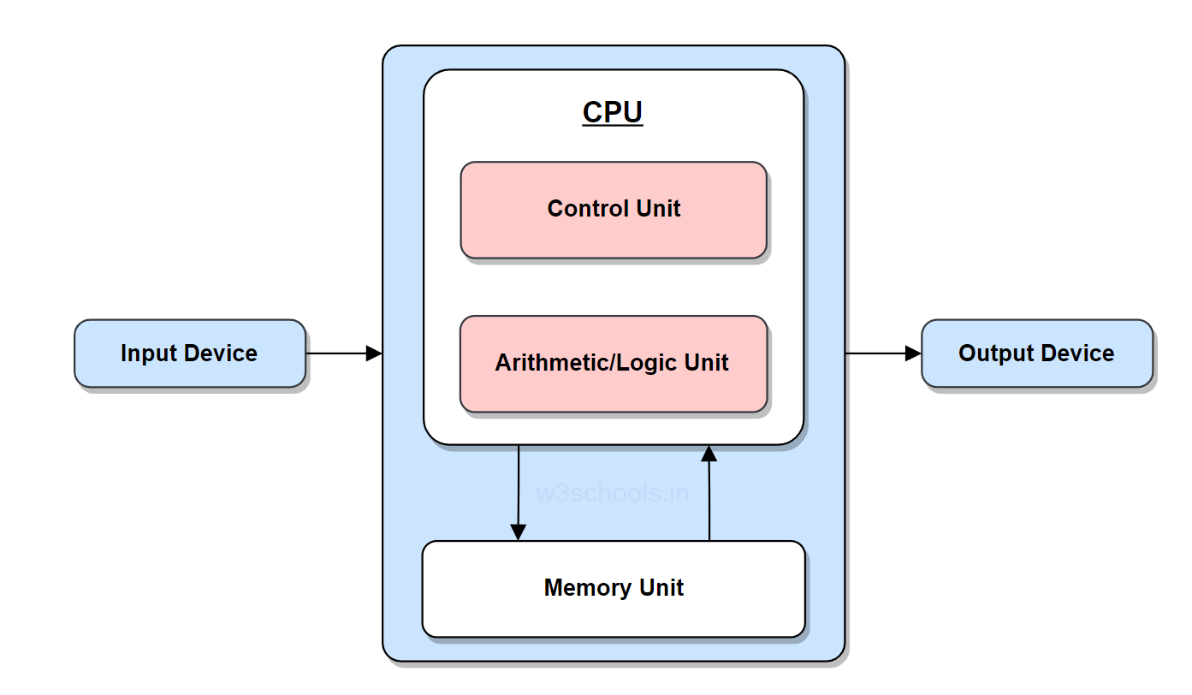
Von-Neumann Architecture

Slide 15
Harvard Architecture
Harvard Architecture consists of code and data laid in distinct memory sections. It requires a separate memory block for data and instruction. It has solely contained data storage within the Central Processing Unit (CPU). A single collection of clock cycles is needed. Data accessibility in one memory is done by a single memory location in the case of Harvard architecture.
One typical example is the Punch card. Moreover, modern computers may have the latest CPU processes for both methods but disparate them in a hardware design.

Slide 16
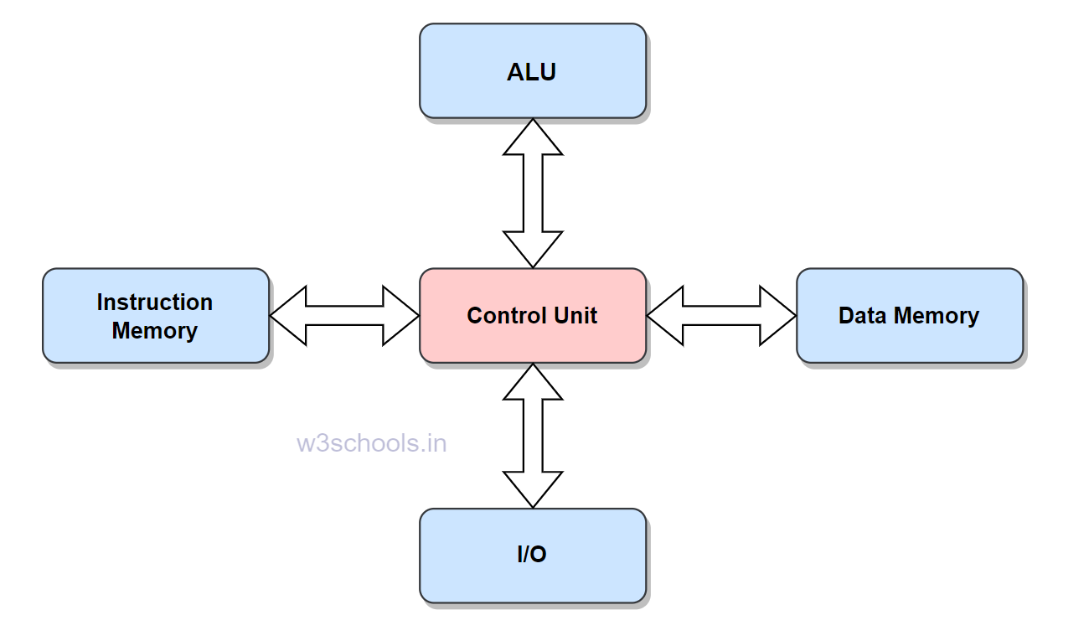
Harvard Architecture

Slide 17
Instruction Set architecture
Another notable digital computer architecture is the Instruction Set Architecture. The architecture holds a collection of instructions that the processor renders and surmises. It consists of two instruction sets: RISC (Reduced Instruction Set Computer) and CISC (Complex Instruction Set Computer).
It enables versatile implementations of an ISA, commonly differing in features such as performance, physical size, and monetary price. It empowers the evolution of the micro-architectures, implementing ISA as an exclusive, higher-performance system that can run software on preceding generations of execution.

Slide 18
Micro-architecture
Micro-architecture is the structural design of a microprocessor. This computer organization leverages a method where the instruction set architecture holds a built-in processor. Engineers and hardware scientists implement instruction set architecture (ISA) with various micro-architectures that vary because of changing technology. It includes the technologies used, resources, and methods. Using this, the processors physically devised to administer a particular instruction set.

Slide 19
Computer Structure and Function
A computer is a complex system; contemporary computers contain millions of elementary electronic components. How, then, can one clearly describe them? The key is to recognize the hierarchical nature of most complex systems, including the computer. A hierarchical system is a set of interrelated subsystems, each of the latter, in turn, hierarchical in structure until we reach the lowest level of the elementary subsystem.
The hierarchical nature of complex systems is essential to both their design and their description. The designer need only deal with a particular level of the system at a time. At each level, the system consists of a set of components and their interrelationships. At each level, the designer is concerned with structure and function. The Structure is how the components are interrelated while the Function is the operation of each component as part of the structure.

Slide 20
Functions of a Computer
Both the structure and functioning of a computer are, in essence, simple. There are four basic functions that a computer can perform.
Data processing
Data storage
Data movement
Control
The computer must be able to process data. The data may take a wide variety of forms, and the range of processing requirements is broad. However, there are only a few fundamental methods or types of data processing. It is also essential that a computer store data. Even if the computer is processing data on the fly (i.e., data come in and get processed, and the results go out immediately), the computer must temporarily store at least those pieces worked on at any given moment. Thus, there is at least a short-term data storage function. The computer performs a long-term data storage function. Files of data are stored on the computer for subsequent retrieval and update. The computer must be able to move data between itself and the outside world. Finally, there must be control of these three functions.

Slide 21
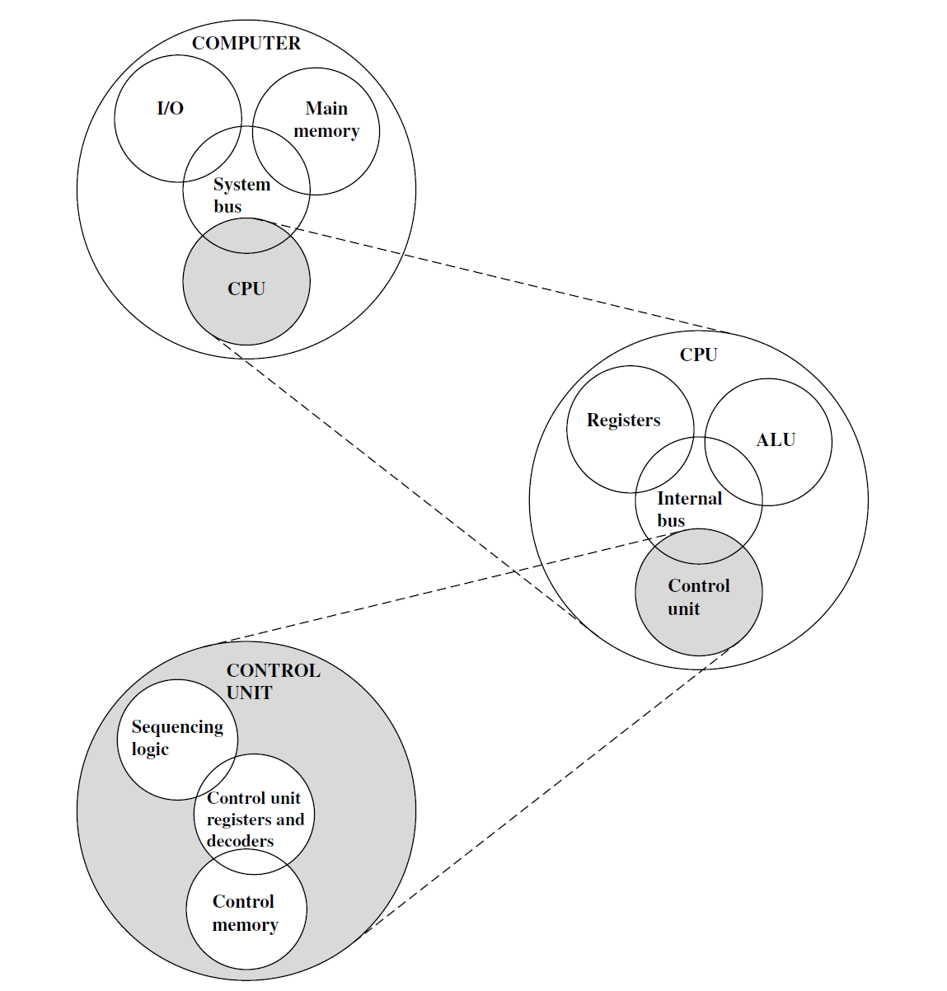
Functions of a Computer

Slide 22
Structural Components of a Computer
There are four main structural components Central processing unit (CPU): Controls the operation of the computer and performs its data processing functions; often simply referred to as processor.
Main memory: Stores data.
I/O: Moves data between the computer and its external environment.
System interconnection: Some mechanism that provides for communication among CPU, main memory, and I/O. A common interconnection is using a system bus, consisting of several conducting wires to which all the other components attach.

Slide 23
Structural Components
There may be one or more of each of the components above. Traditionally, there has been just a single processor. In recent years, there has been increasing use of multiple processors in a single computer. Some design issues relating to multiple processors crop up. The most interesting and in some ways the most complex component is the CPU. Its major structural components are as follows:
Control unit: Controls the operation of the CPU and hence the computer.
Arithmetic and logic unit (ALU): Performs the computer’s data processing functions.
Registers: Provides storage internal to the CPU
CPU interconnection: Some mechanism that provides for communication among the control unit, ALU, and registers

Slide 24
Data Representation
• INTRODUCTION
Data Representation refers to the methods used internally to represent information stored in a computer.
• Computers store lots of different types of information:
- Numbers
- Text
- Graphics of many varieties (video, animation)
- Sound

Slide 25
Data Representation
Introduction
Humans see data differently.
• ALL types of information stored in a computer are stored internally in the same simple format:
A sequence of 0's and 1's.
•How can a sequence of 0's and 1's represent things as diverse as your photograph, a song, a movie, and number?

Slide 26
Basic Terms
• Computers use numeric codes to represent all the information stored.
These codes are similar to those you may have used as a child to encrypt secret notes:
e.g. let 1 stand for A, 2 stand for B, 3 for C etc.
With this type of code representation, any written message can be represented numerically. However, the codes used by computers are a bit more sophisticated, and they are based on the binary number system. Computers use a variety of different codes for numbers, others for text, and still others for sound and graphics.

Slide 27
Data Representation
The computer memory stores data in bits (0 or 1)
A Bit is one Binary digit.
A single bit can represent 2¹ = 2 pieces of information.
This is the most basic unit of information in a computer.
A Byte is a group of eight (8) bits. It represents one of 2⁸ = 256 possibilities. The size of objects stored in computer memories is customarily measured in bytes rather than bits.
A Nibble is a group of four (4) bits, or half a byte. It represents one of 2⁴ = 16 possibilities. Nibbles are no longer a commonly used units.
A Word is the number of bits in each memory location. The word is usually in multiples of bytes e.g one, 2, 4, or 8 bytes.

Slide 28
Data Representation
Word is the number of bits in each memory location. It is also equal to the number of bits in the data bus
of the processor and usually in multiples of bytes e.g one Byte, 2, 4, or 8 bytes).
– a 2 byte word can represent 256 x 256 = 2^{8.}2⁸ pieces of information (65,536).
Byte addressable means that each byte has its own address.

Slide 29
Denary Numbers (Base 10)
In elementary school, we learned to count and do arithmetic in decimal, one could count using ten fingers for this. There are ten decimal digits, 0, 1, 2, ..., 9. Decimal digits are joined together to form longer decimal numbers.
Each column of a decimal number has ten times the weight of the previous column. From right to left, the column weights are 1, 10 (tens), 100 (hundred), 1000 (thousand) and so on.
Decimal numbers are referred to as base 10. The base is indicated by a subscript after the number - 20₁₀ to prevent confusion when working in more than one base.

Slide 30
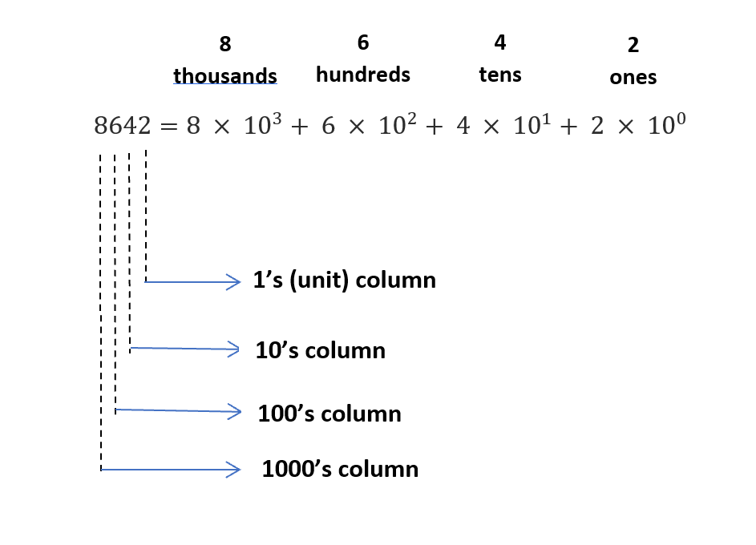
Base 10
For example, decimal number 8642 is written as the sum of each of its digits multiplied by the weight of the corresponding column.

Slide 31
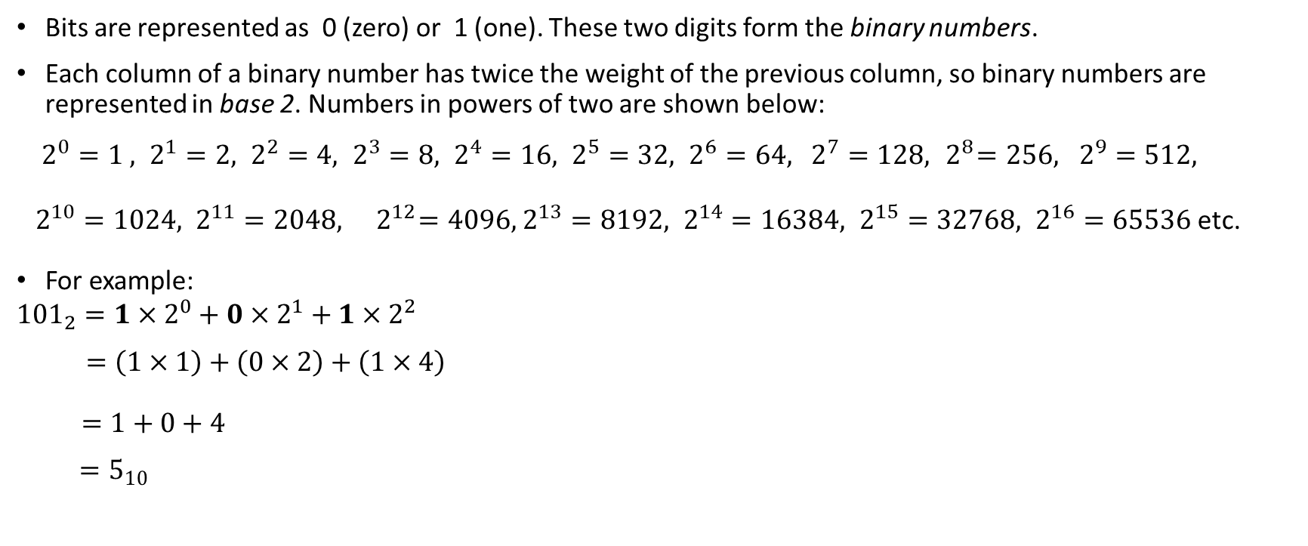
Binary Numbers (Base 2)
Bits are represented as 0 (zero) or 1 (one). These two digits form the binary numbers.
Each column of a binary number has twice the weight of the previous column, so binary numbers are represented in base 2. Numbers in powers of two are shown below:
$2^{0}=1 , 2^{1}=2, 2^{2}=4, 2^{3}=8, 2^{4}=16, 2^{5}=32, 2^{6}=64,$ $2^{7}=128, { 2}^{8}=256, 2^{9}=512,$
$2^{10}=1024, 2^{11}=2048,{ 2}^{12}=4096,$ $2^{13}=8192, 2^{14}=16384, 2^{15}=32768, 2^{16}=65536$ etc.
For example:
$${101}_{2}=1×2^{0}+0×2^{1}+1×2^{2}$$
$$=\left(1×1\right)+\left(0×2\right)+\left(1×4\right)$$
$=1+0+4$
$$=5_{10}$$

Slide 32
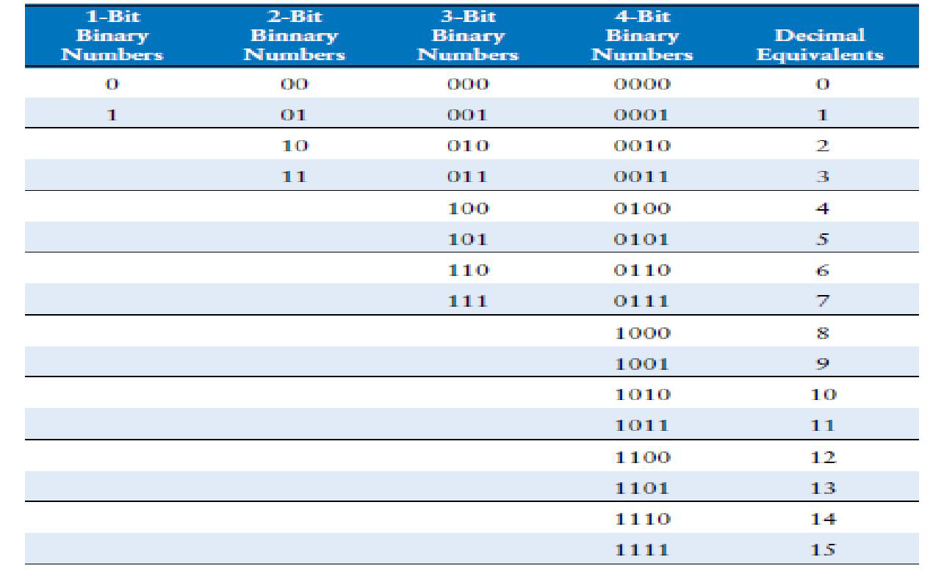
N-Bits and their Decimal Equivalent

Slide 33

Hexadecimal Numbers
Writing long binary numbers becomes tedious and prone to error. A group of four bits represents one of $2^{4}=16$ possibilities. Hence, it is sometimes more convenient to work in base 16, called hexadecimal.
Hexadecimal numbers use the digits 0 to 9 along with the letters A to F. Columns in base 16 have weights of
${16}^{0}=1 , {16}^{1}=16, {16}^{2}=256, {16}^{3}=4096, {16}^{4}=16, {16}^{5}=32, {16}^{6}=64,$ etc.

Slide 34
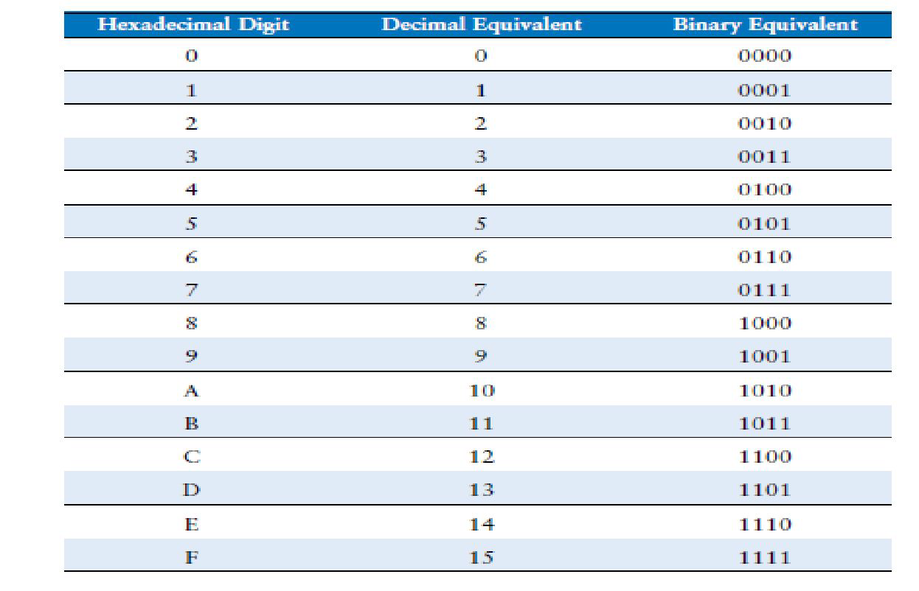
Hexadecimal Number System

Slide 35
Character Codes
It is important to consider how numeric values can be converted to a form that is meaningful to humans. The manner in which this is done depends on the coding system used by the computer and how the values are stored and retrieved.

Slide 36
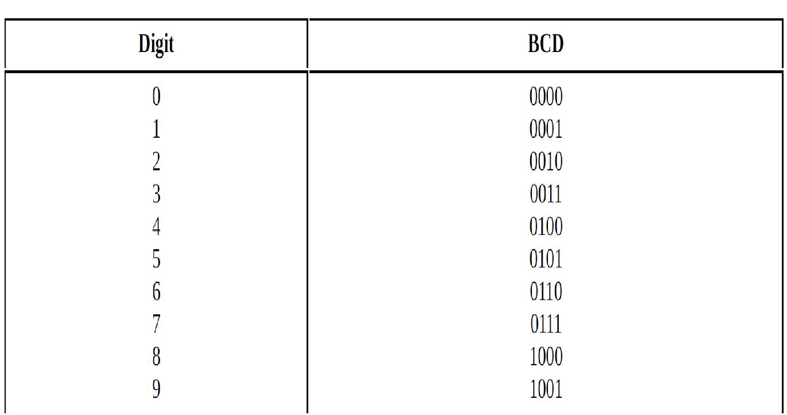
Binary Coded Decimal

Slide 37
Binary Coded Decimal (BCD)
Binary-coded decimal (BCD) is commonly used in electronics, particularly those that display numerical data, such as alarm clocks and calculators. BCD encodes each digit of a decimal number into a 4-bit binary form. Each decimal digit is individually converted to its binary equivalent. BCD does not exist for decimal values 10-15 i.e. 1010 through 1111 in binary.
For example, to encode 250, the decimal digits are replaced by 0010, 0101, and 0000, respectively. Because most computers use bytes as the smallest unit of access, most values are stored in 8 bits, not 4 bits. Therefore there are ways 4-bit BCD digits are stored.

Slide 38
Binary Coded Decimal
There are two types of BCD representations:
Unpacked binary coded decimal
The cost of extra bits can be ignored and pad the high-order nibbles with zeros (or ones), forcing each decimal digit to be replaced by 8 bits. Using this approach, padding with zeros.
251, would be stored as 00000010 00000101 00000001. One can see that this approach is quite wasteful.
2. Packed binary coded decimal
Packed BCD stores two digits per byte. Packed decimal format allows numbers to be signed, but instead of putting the sign at the beginning, the sign is stored at the end.
The standard values for this “sign digit” are 1100 for +, 1101 for –, and 1111 to indicate that the value is unsigned. Using packed decimal format, +251 would be stored as
00100101 00011100, -251 would be stored as 00100101 00011101.

Slide 39
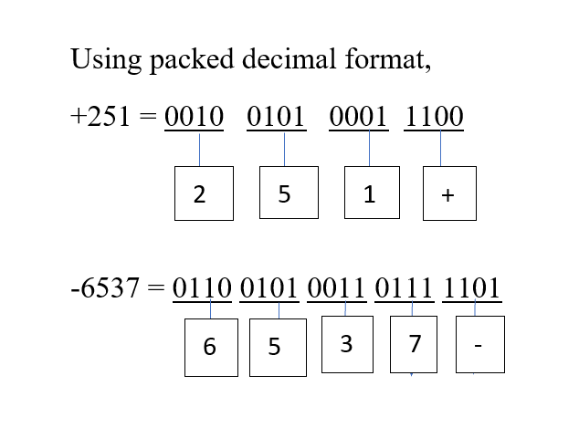
Packed Binary Coded Decimal (Packed-BCD)

Slide 40
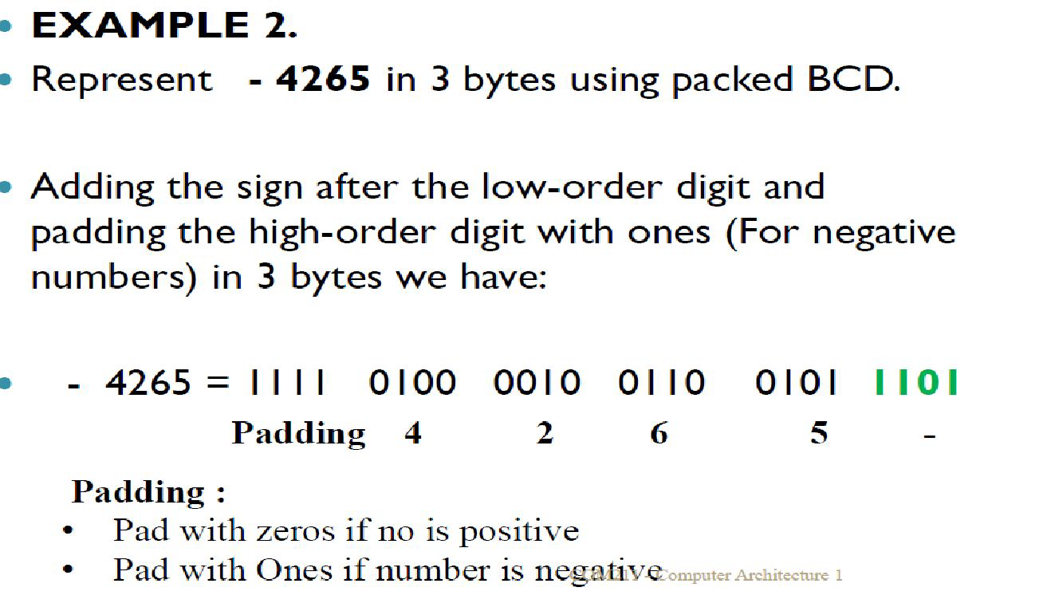
Packed Binary Coded Decimal (Packed - BCD)

